Slide 1

Nemo
Factory database system

Slide 2



It consists of
Supervisor
Worker
Manager

Slide 3
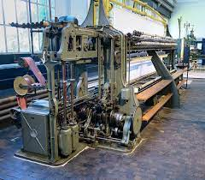
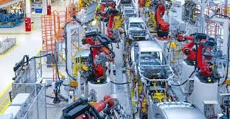
System
Machine
Product
Production Line

Slide 4
Production line
Supervisor
Production Line
Manages

Slide 5
System
Worker
Machine
Works on

Slide 6
Manager
Have access to everything
See overall statistics
Insert
Update
Delete

Slide 7
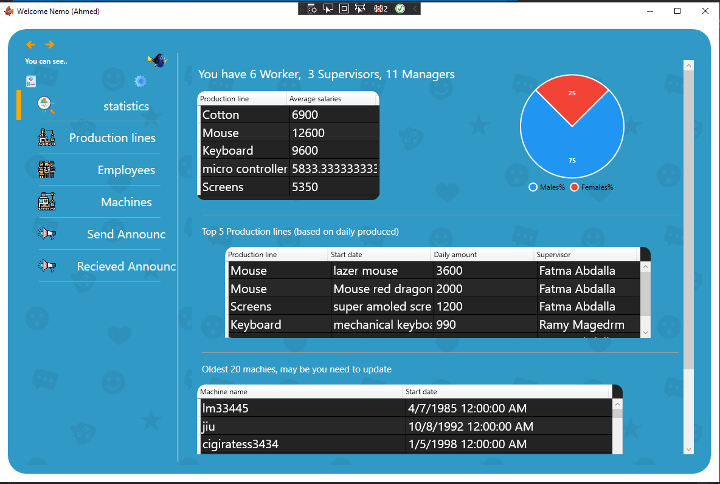
Statistics

Slide 8
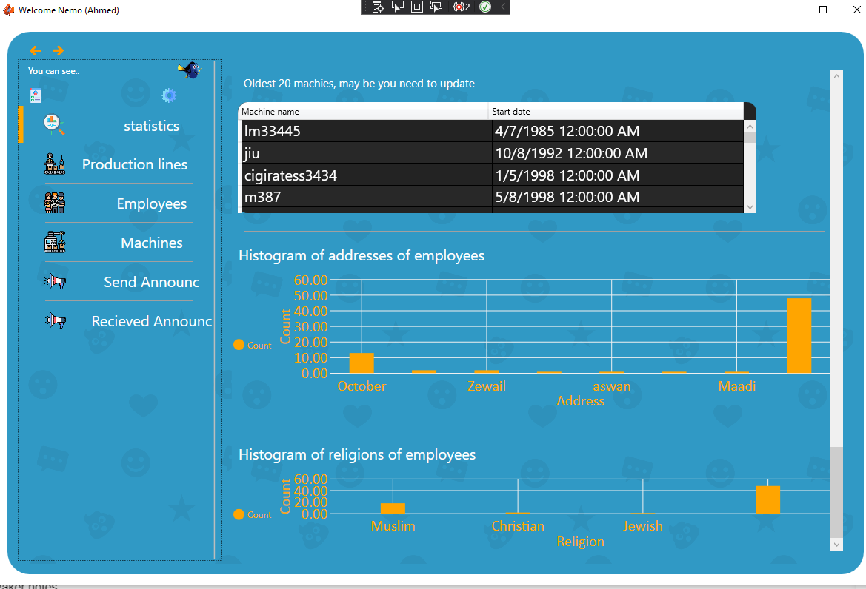
Statistics

Slide 9
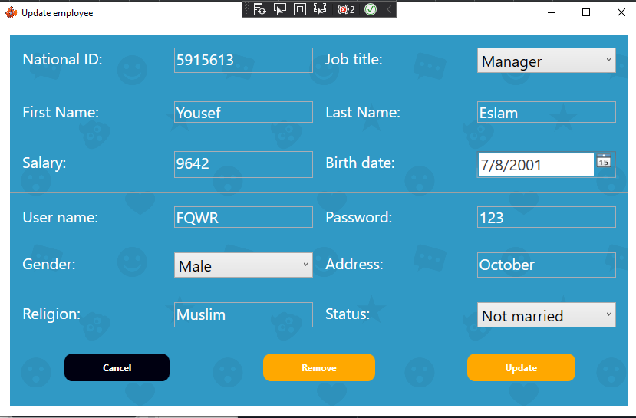
Update Employee

Slide 10
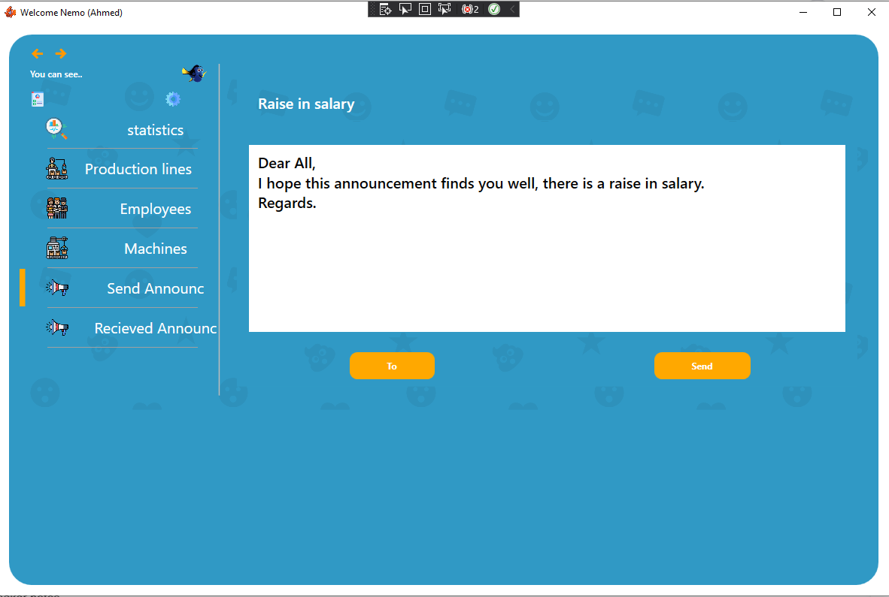
Send Announcements

Slide 11
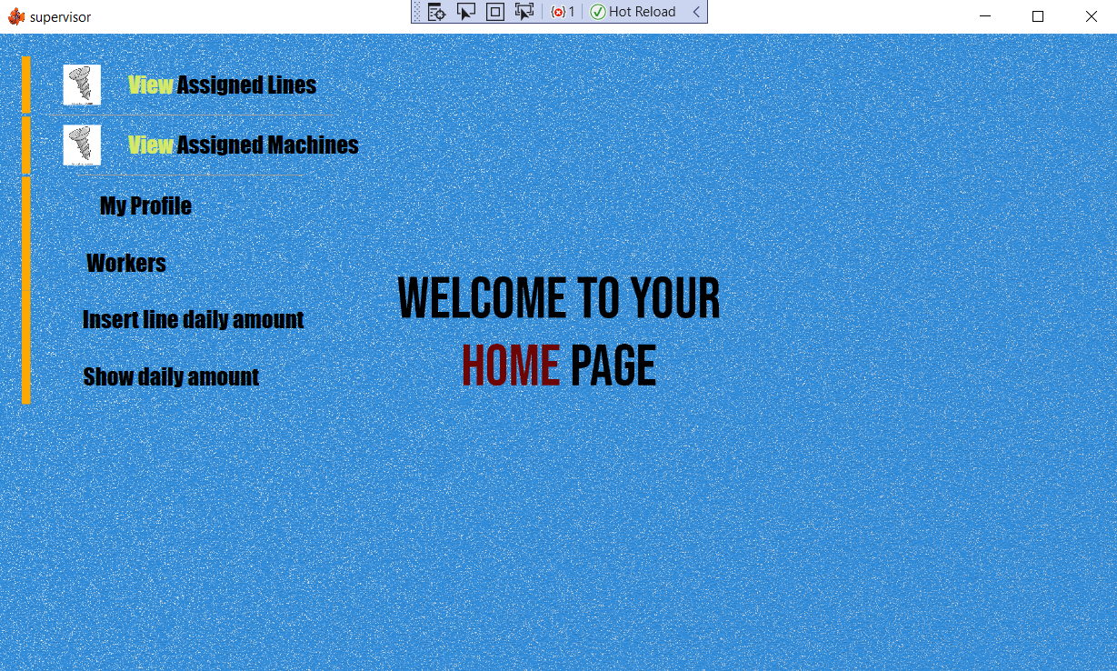
Supervisor main view

Slide 12
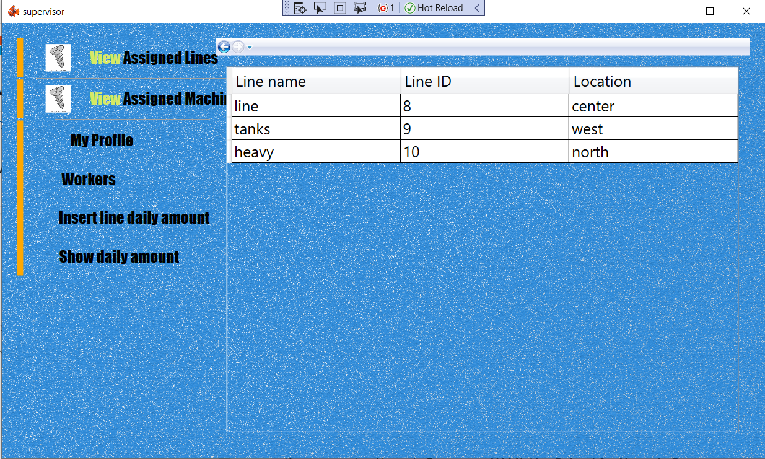
Option 1: view assigned lines

Slide 13
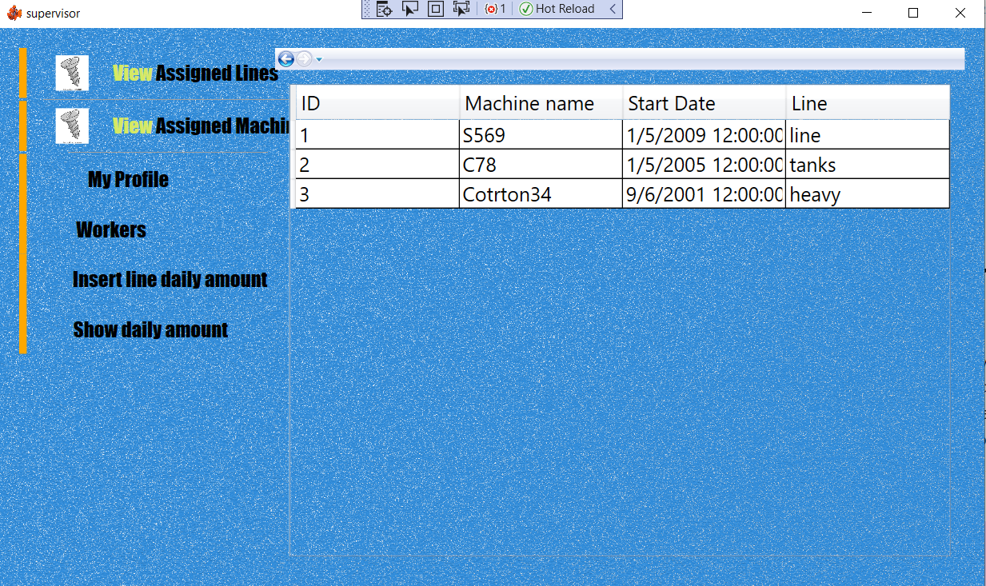
Option 2: view assigned machines

Slide 14
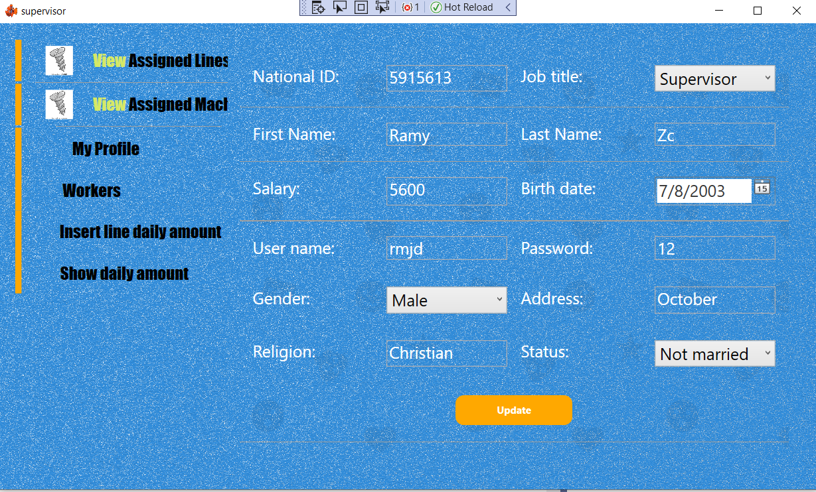
Option 3: view profile

Slide 15
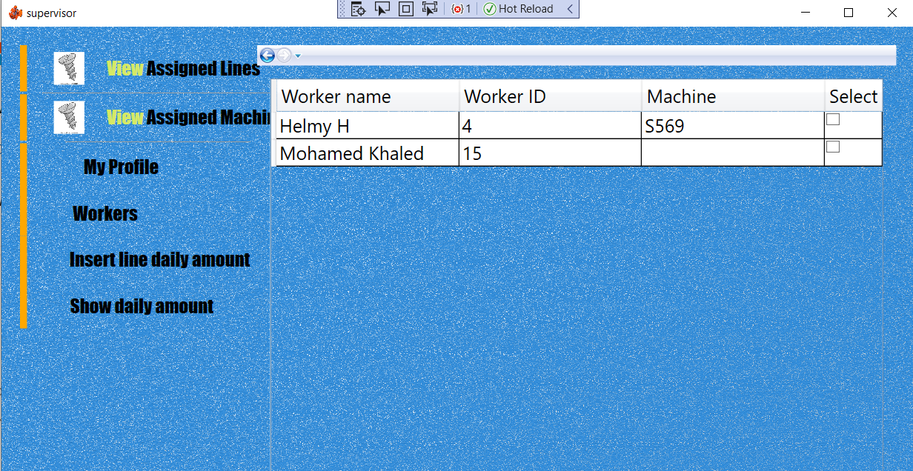
Option 4: view workers
note: supervisor can view workers assigned to him and workers who are not assigned yet to assign some of them if needed by selecting then a button will appear to choose a machine

Slide 16
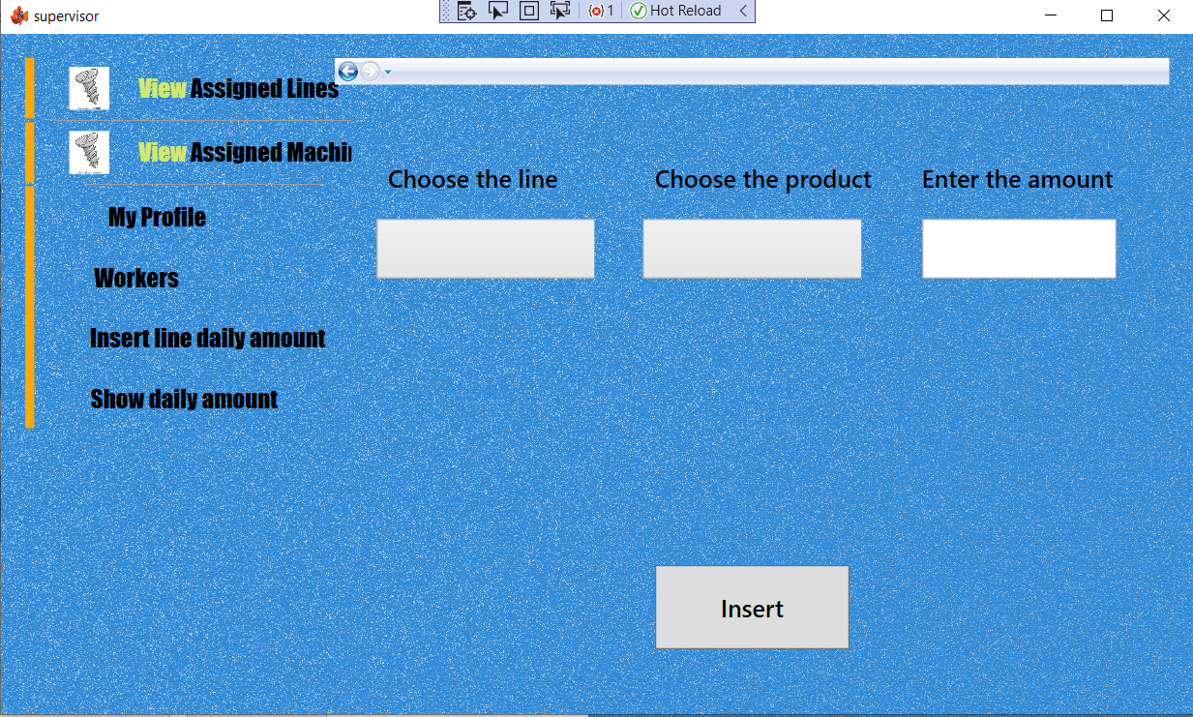
Option 5: Insert/update Daily production of a line
supervisor can view 2 drop down menus of his assigned lines and all the products
then enters the amount in the text box

Slide 17
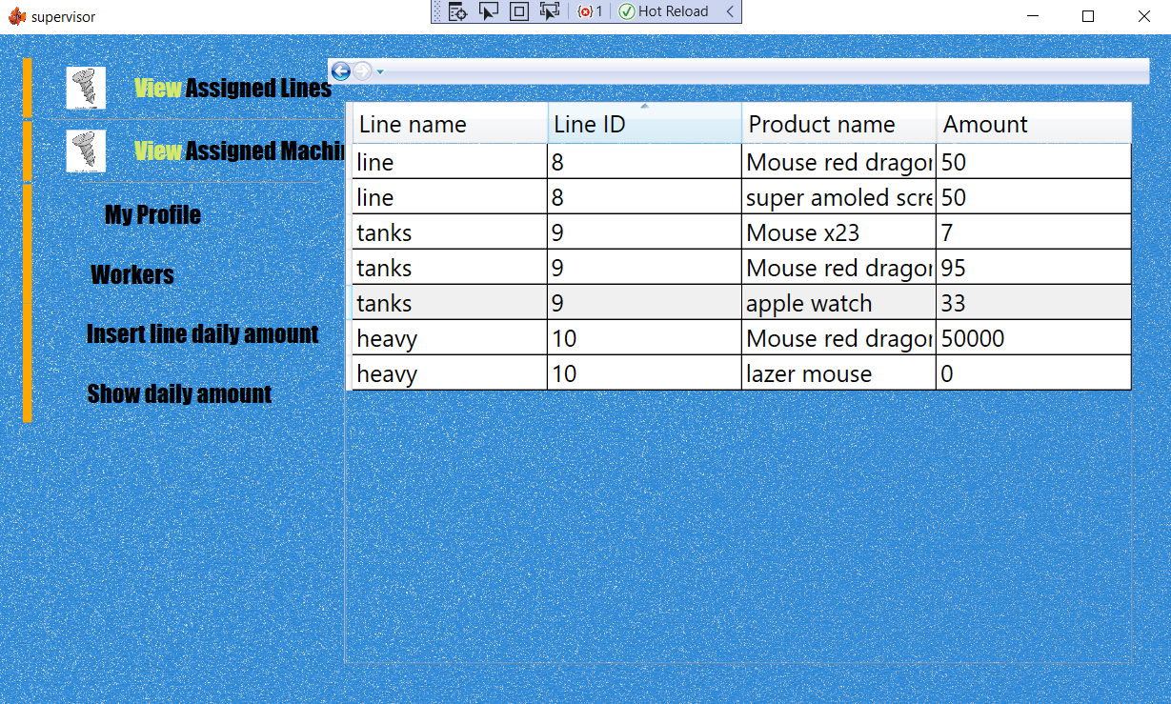
Option 6: view daily production amount of lines if exists

Slide 18
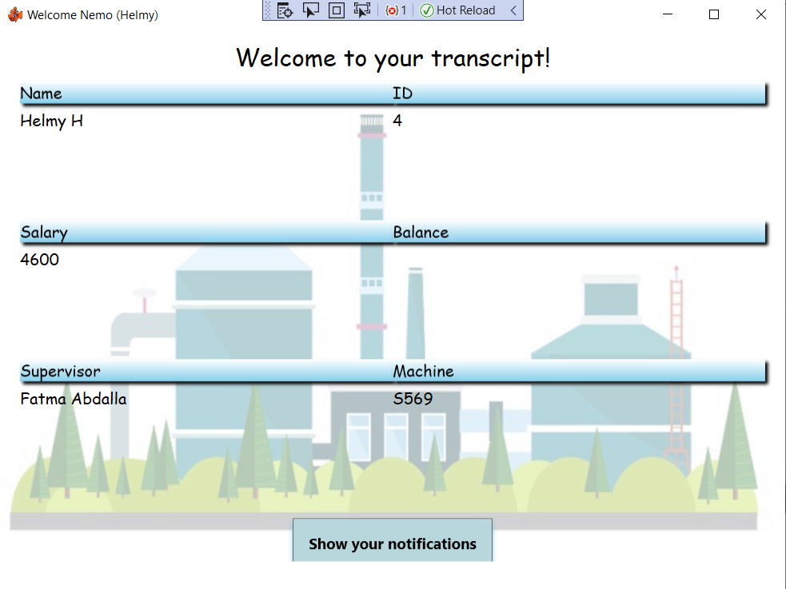
Worker Main View
Worker can view their transcript and can see any announcements from manager or supervisor

Slide 19
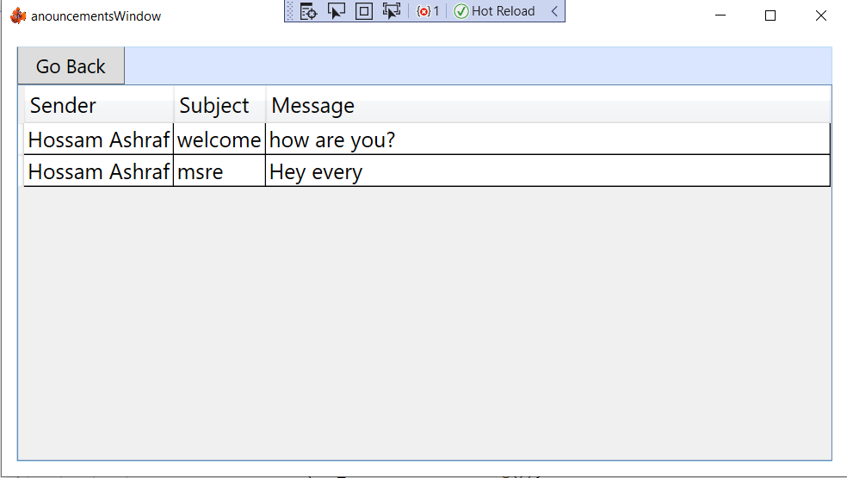
Worker notification window

Slide 20
Thanks

